Slide 1
Final Project
Battle of the Neighborhoods – Honeymoon Itinerary

Slide 2
Introduction
In planning for our wedding, I wanted to attack this project from a different view. The goal of this project was to take locals, use geocoding, and different types of maps to track down some of the more popular spots to visit in Paris, France. The conclusion will be a finalized itinerary for our Honeymoon and all finalizations will be established by using geocoding and local position through Jupyter Notebook.

Slide 3
Data Used
List of preferred localities
General geo-mapping from Paris and surrounding areas
List of Top locations; hotspots
General mapping through Bing and other API

Slide 4
Methodology
After defining the source of data, I will perform the collection of data and several cleaning processes.
After data is loaded and clean, I will perform various drive downs to determine various hotspots near and surround Paris, France.
Use machine learning techniques to determine areas that may become overcrowded at certain times during the trip

Slide 5

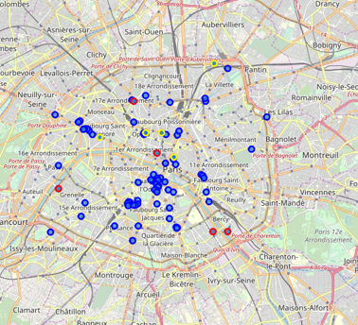
Map of Destination
Map shows various hotspots that are characterized as follows:
Blue – Common, Light Traffic
Yellow – Higher Traffic
Red – Highest Traffic, Very Busy

Slide 6
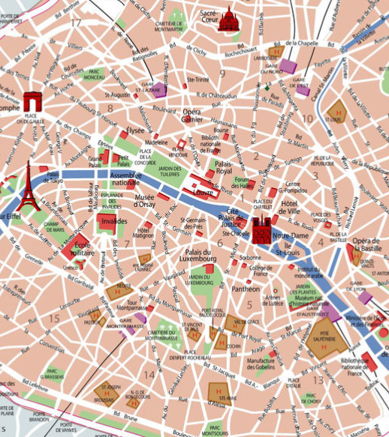
Map Compare
For comparison I have included a map found online that shows the general hotspot areas.

Slide 7
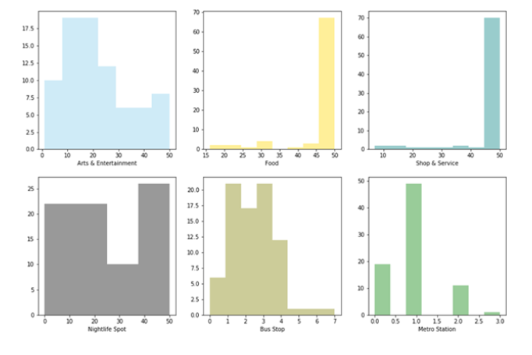
Entertainment Types

Slide 8
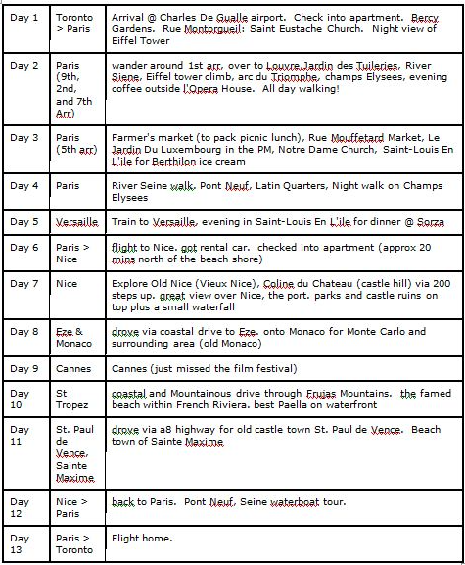
Conclusion

